Slide 1
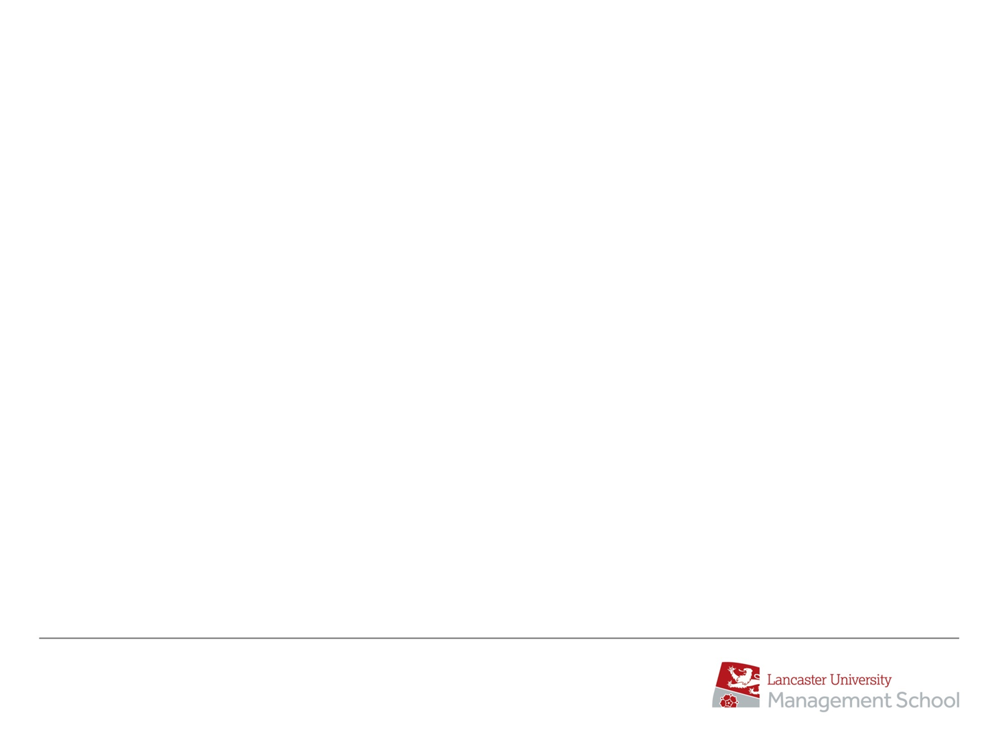
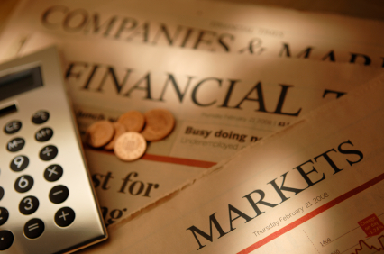

AcF 304 Financial Markets – Week 14 Commercial Awareness
Session Code:
937691
Notes:
If this PowerPoint presentation contains mathematical equations, you may need to check that your computer has the following installed:
1) MathType Plugin
2) Math Player (free versions available)
3) NVDA Reader (free versions available)

Slide 2
Key themes today – reference 2022
Interest rates / bond yields up / bond prices down
Equity prices down
Why inflation bad for stock market (and bonds)
How the FED makes decision and communicates
Market language – Dovish & Hawkish
Inflation up
NASDAQ fell more than S&P 500
Classic portfolio theory broken (2022)
End 2023 Fed ‘pivoted’
Session Code:
937691

Slide 3
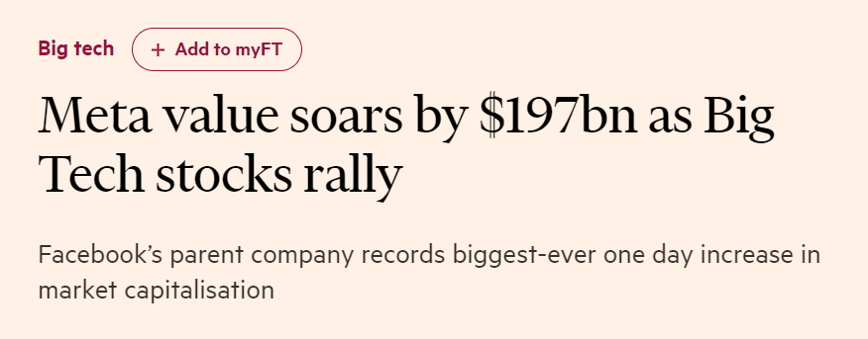

Friday Feb 2nd…
Not assessible

Slide 4
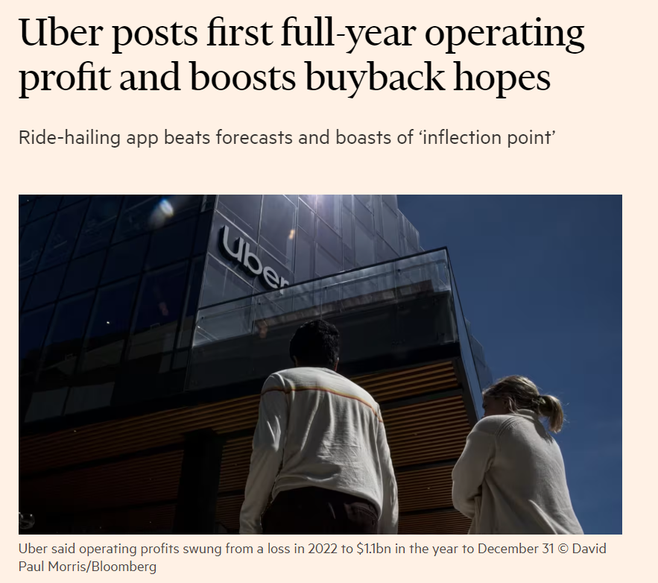
…
Not assessible

Slide 5
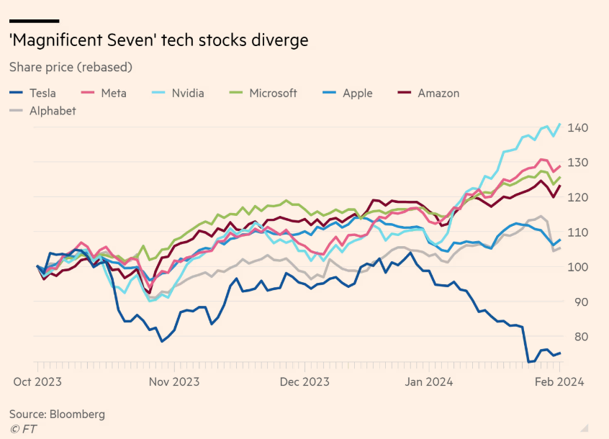
Not assessible
Not accessible

Slide 6
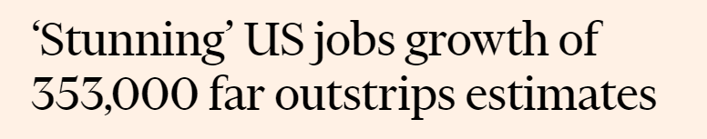
Friday Feb 2nd…
US 2-year Treasury Bond rose 0.20% to 4.20%
US 10-year Treasury Bond rose 0.16% to 4.12%
(Week 12 = 3.94%)

Slide 7
US NON-FARM PAYROLLS (JOBS)
This is the most important economic data release in the world (normally…inflation numbers temporarily taken over)
The number of people that secure jobs in a particular month in the world’s largest economy i.e. join the payroll
NON-FARM: Excluding seasonal agricultural workers
Assessible

Slide 8
US NON-FARM PAYROLLS (JOBS)
This is the most important economic data release in the world (normally…inflation numbers temporarily taken over)
It drives markets !
It is released on first Friday of every month at NY 8.30 AM / UK 1.30 PM
All traders will be glued to their desks for the news
Markets can move very sharply immediately on the news release

Slide 9
US NON-FARM PAYROLLS (JOBS)
Why so important?
US is the largest economy in the world
The jobs data shows the status of that economy
Has implications for US interest rates (Fed Funds, Bond Yields etc..)

Slide 10




US NON-FARM PAYROLLS (JOBS)

Slide 11
US NON-FARM PAYROLLS (JOBS)
If the median forecast is +100,000 for January
What if the figure came in at +300,000 or more?
It would show the US economy is rebounding really strongly
More chance of inflation (remaining strong)
More chance of higher interest rates therefore
Bond yields up / bond prices down
Stocks down because of higher interest rates (but encouraged by news on economy)
USD Strengthen

Slide 12
US NON-FARM PAYROLLS (JOBS)
If the median forecast is +100,000 for January
What if the figure came in at -200,000 or less?
It would show the US economy is slowing down (after 2022/23 sharp interest rate rises)
Less chance of inflation staying strong
Less chance of higher interest rates therefore
Bond yields down / bond prices up
Stocks up because of lower interest rates (but concern about economy)
USD Weaken

Slide 13
US NON-FARM PAYROLLS (JOBS)
If the median forecast is + 350,000
Figure comes out at +20,000
Stock Market UP or DOWN?
UP
A lot or a little?
A LOT

Slide 14
US NON-FARM PAYROLLS (JOBS)
If the median forecast is + 350,000
Figure comes out at +20,000
10-year Bond Prices
UP or DOWN?
UP
A lot of a little
A LOT

Slide 15
US NON-FARM PAYROLLS (JOBS)
If the median forecast is + 350,000
Figure comes out at +20,000
US Dollar UP/Strenghten or DOWN/Weaken ?
Weaken

Slide 16
US NON-FARM PAYROLLS (JOBS)
If the median forecast is + 350,000
Figure comes out at +550,000
US Dollar UP/Strenghten or DOWN/Weaken ?
Strengthen

Slide 17
US NON-FARM PAYROLLS (JOBS)
If the median forecast is + 350,000
Figure comes out at +550,000
Stocks
Fall
Lot or Little?
A LOT

Slide 18
US NON-FARM PAYROLLS (JOBS)
If the median forecast is + 350,000
Figure comes out at +550.000
Bond Prices
Down

Slide 19
US NON-FARM PAYROLLS (JOBS) January 2024
If the median forecast is +185,000 – it was
Figure comes out at +353,000
So what looks like good economic news is not for financial markets

Slide 20
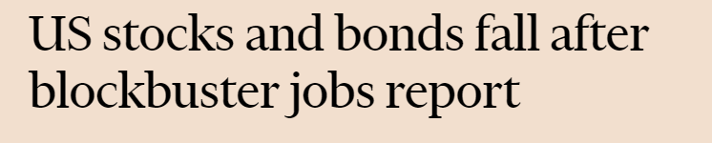
US NON-FARM PAYROLLS (JOBS)

Slide 21
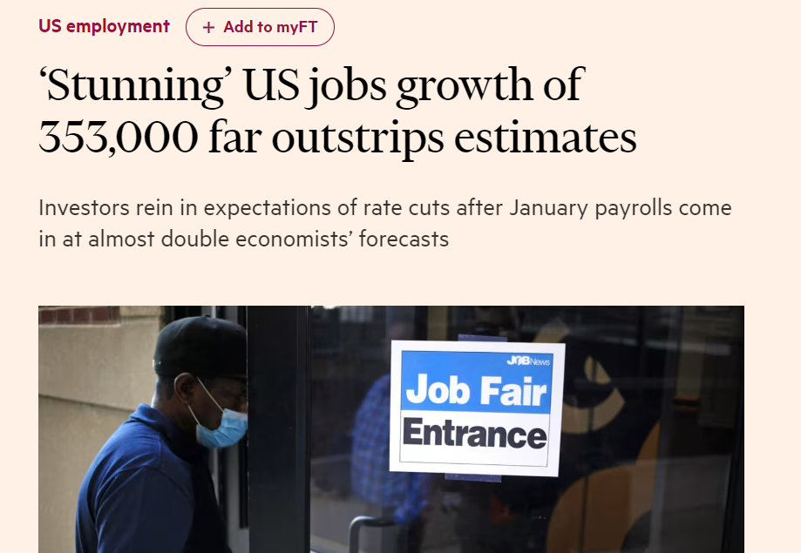
Not accessible

Slide 22
Last Friday…
Bond Yields?
UP
Bond Prices?
Down
Stock Prices?
Down
US Dollar
UP

Slide 23
Debt to GDP Ratios
Debt-to-GDP ratio, an economic metric comparing a country's government debt to its GDP, is pivotal for evaluating economic stability and repayment ability.

Slide 24
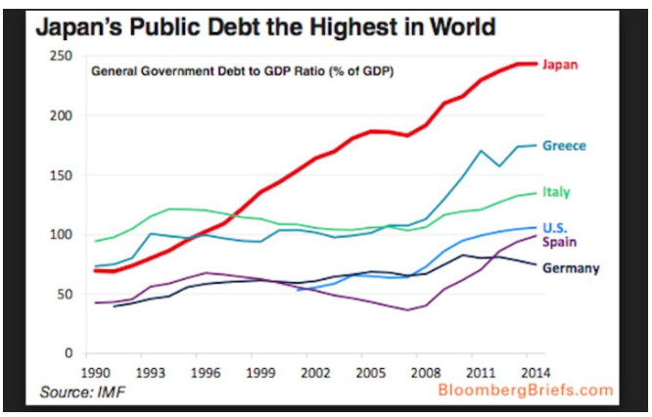
Question: Debt to GDP Ratios
Today
US 133%
UK 108%

Slide 25
Question: Debt to GDP Ratios
Today
US 133%
UK 108%
What is an appropriate Debt/GDP Ratio?
What makes a certain level of debt to gdp ratio sustainable?
One of the Euro convergence criteria was that government debt-to-GDP should be below 60%.

Slide 26
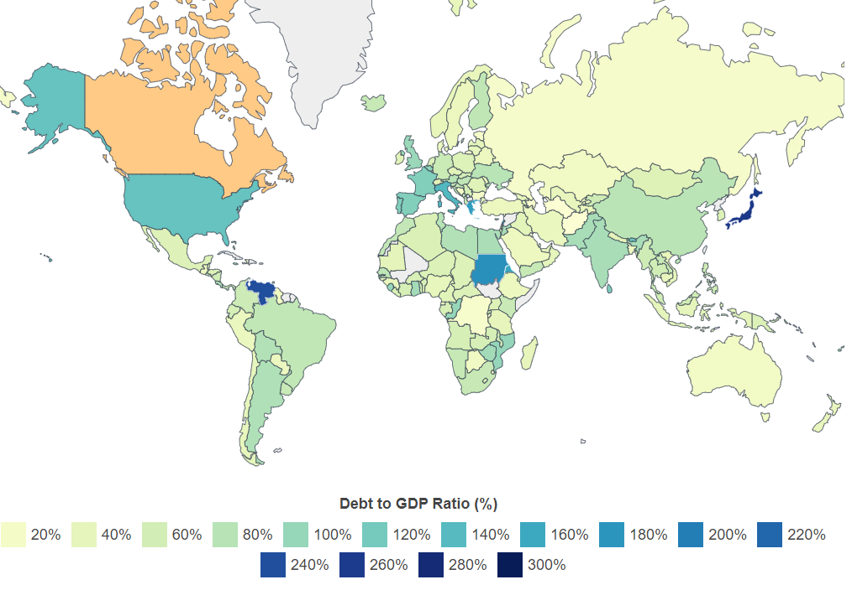

Slide 27
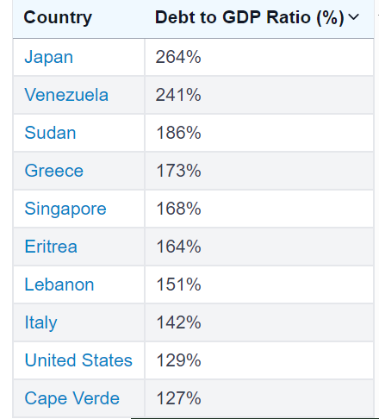
Top 10 Countries with highest ratios

Slide 28
Question: Debt to GDP Ratios
Today
US 133%
UK 108%
One major consideration is who the debt is owed to?
Greece for example owed a lot of its debt to foreign Creditors.
Even in the US a lot of foreign buyers buy US Government Bonds

Slide 29
Question: Debt to GDP Ratios - JAPAN
The Japanese position is much different than the US position
Most of the Japanese debt is owned by Japanese people (90% of current debt).
More specifically the BOJ plays a big role as a buyer, and puts pressure on Japanese yields, which makes it cheaper for the government to issue bonds!
Japan is the biggest creditor in the world. The country holds a net amount of about 3 trillion USD (367 trillion yen) of financial assets throughout the world which makes Japan the largest creditor worldwide (before China!)

Slide 30
GameStop – Jan 2021 https://theprint.in/theprint-essential/the-gamestop-story-how-a-group-of-investors-on-reddit-gave-wall-street-a-wild-week/595181/
US chain of video game retail stores (Outdated Business)
A stock valued at just $3.25 six months earlier rallied by 8000 per cent.

Slide 31
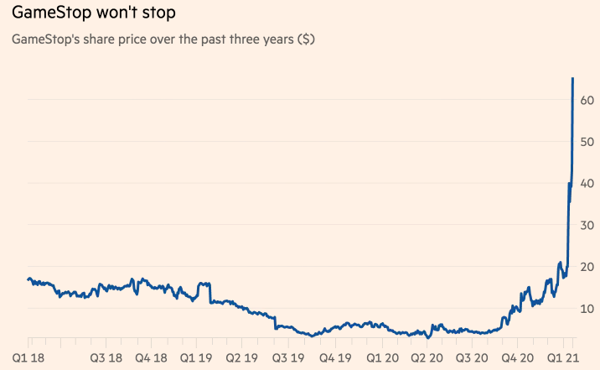
GameStop – Jan 2021

Slide 32
GameStop – Jan 2021
So, how did a company with a doomed, outdated business model, become the most talked about stock?
The answer is r/wallstreetbets, a group of retail investors on an internet forum called Reddit who raised the stock price by initially 1,700 per cent
Day trading, short selling and hedge funds.
Day trading refers to buying and selling stocks multiple times during the day. By day trading, one aims to make small profits that add up as they trade.
Short selling is a way of profiting off the price of an asset which is falling.
Hedge funds are a group of investors that are supervised by a money manager. These hedge funds aim to make profits by short selling on failing stocks.

Slide 33
GameStop – Jan 2021
Over the years, GameStop’s stock had been falling. Reddit users noticed hedge funds were heavily short selling the stock, particularly the $13 billion hedge fund Melvin Capital.
In mid-2019, a Reddit user (Roaring Kitty) posted a picture showing a $53,000 investment in GameStop. Though the post didn’t get any attention then, the user frequently tweeted about the retail store and the investment. Finally it caught the attention of many young online traders. This led to the share prices increasing to unwarranted levels
Short sellers lost an estimated $23.6 billion on GameStop in this rally. Melvin Capital lost 30 per cent of the $12.5 billion it invested in managing shorted stocks

Slide 34
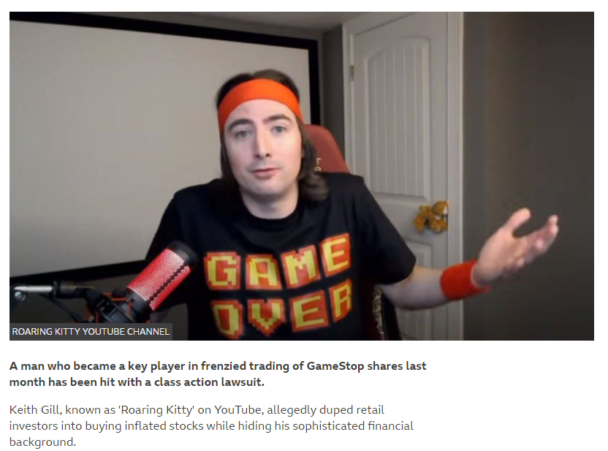
GameStop

Slide 35
GameStop – Jan 2021
After hedge funds lost money, Wall Street demanded that short selling be made illegal even though it’s a practice commonly used by everyone. In order to avoid a stock crash, trading apps like Robinhood stopped the purchase of GameStop on their platform.
This led to a massive backlash on social media where “the rich” were accused of manipulating the stock market in a way that kept others out. Several Congress members also cried foul.
Even prompted the White House to look into the matter.

Slide 36

Q&A
How can trading platforms like Robinhood stop the buying of GameStop shares during a buying frenzy? Doesn’t this break some kind of regulation/law?
Robinhood cited "extreme volatility" as their reason to suspend trading.
While it's not uncommon for trading in a particular stock -- or indeed in the market as a whole -- to be halted during times of extreme volatility, the suspension of GME for much of the trading day led to a public outcry, because retail investors were concerned brokerages took action to protect Wall Street insiders from outsized losses

Slide 37
GameStop
Investors had sued Robinhood alleging they lost money when they couldn't trade out of GameStop and other stocks. At the time, Citadel executed a large portion of Robinhood's trades under an industry business model known as payment for order flow.

Slide 38
GameStop
Payment for order flow (PFOF) is a form of compensation, usually in terms of fractions of a penny per share, that a brokerage firm receives for directing orders for trade execution to a particular market maker or exchange. .

Slide 39
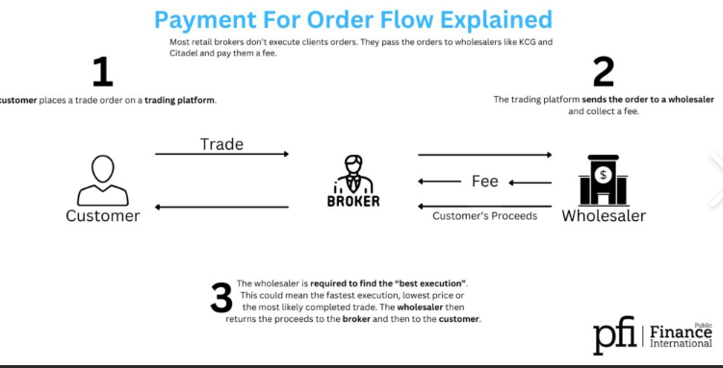
Payment for order flow (PFOF) is a form of compensation, usually in terms of fractions of a penny per share, that a brokerage firm receives for directing orders for trade execution to a particular market maker or exchange. .

Slide 40
Key themes today
Non-Farm Payroll economic data release and affect on financial markets
Debt/GDP ratios - focus on Japan
GameStop +8000%
..including Payment For Order Flow
Session Code:
937691

